Slide 1
Getting Started with Data Visualization: Elements of Design!
Alison Blaine, Jennifer Garrett, & Hannah Rainey
Notes:
Intro

Slide 2
Goals
After this session you should leave with:
an understanding of the process for making good visualizations
an introduction to core design concepts
exposure to various chart types
practice doing a visualization “make over”
Most importantly, we hope you learn that you can always get more help!

Slide 3
Agenda
Overview
Basic Design Considerations
Characteristics of Bad & Good Visualizations
Best practices for visualizing data
Resources for choosing the right chart type
Additional design considerations
Hands-on activity

Slide 4
Workshop materials folder
go.ncsu.edu/startviz2
Notes:
Jennifer

Slide 5
What is data visualization?
Why visualize?
Notes:
Jennifer & Alison
Broadly, data visualization is anything that converts data into a visual representation - so a graph, a bar chart, a map.
At least in the libraries, we have heard the term “data visualization” come up more and more often from our users. We don’t argue that visualizations are always needed, but depending on one’s research there are many reasons that might support visualizations as a useful component of data analysis or research in general. It’s easier for our brains to absorb visual information, and so if you need to communicate something quickly about a data set, a visual representation is often a good idea.

Slide 6
Data Visualization Process
getting data
getting to know the data
setting goals
determining if a visualization is needed
deciding what to visualize
cleaning
visualizing
designing
exporting/embedding for presentation
Notes:
Alison

Slide 7
Basic Design Considerations
Color
Type
S P A C E

Slide 8
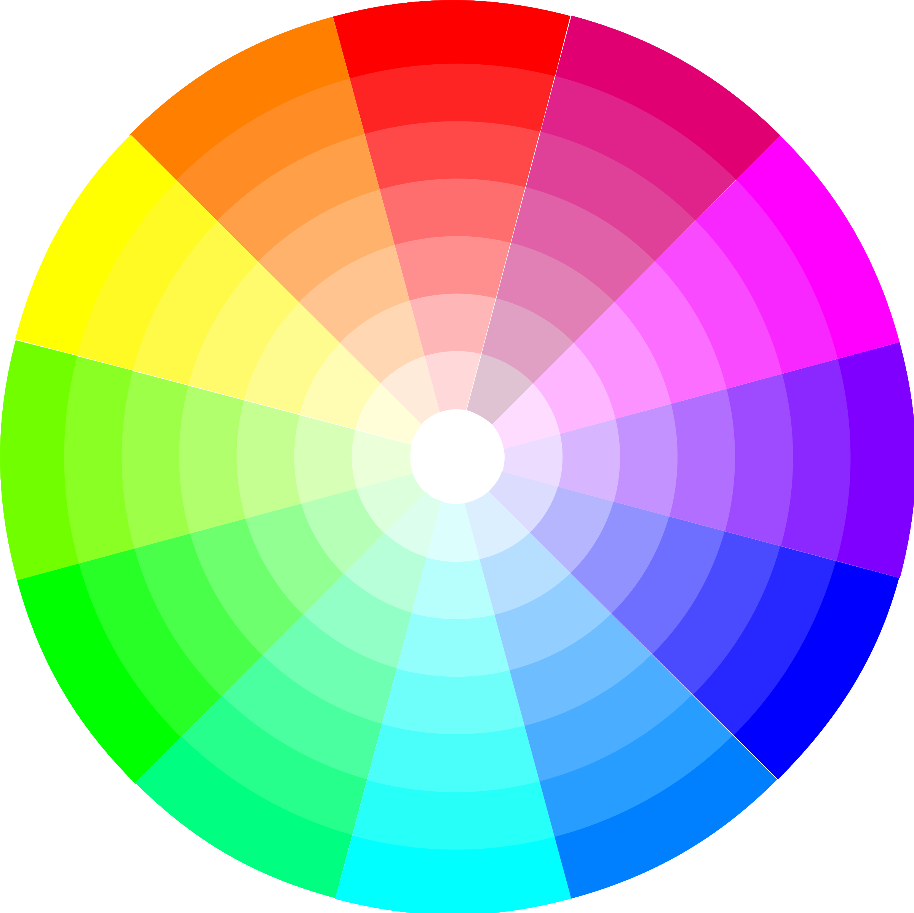
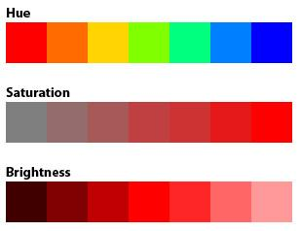
Color Characteristics
Hue = color name
Chroma = saturation
Value = brightness
Notes:
Hannah
Hue, Value, and Chroma are the 3 basic elements of color that can be leveraged in creating data visualizations. Highly saturated colors are attention grabbing but also whimsical. There are a number of factors that go into color selection. Each of these color variations can be written as a code that a computer can understand, either Hex or RGB value. They are different ways of writing the same thing. Hex codes are in base 16 and RGB is base ten. If you have the hex code “#0088FF”. This breaks down into:
Red: 00,
Green: 88,
Blue: FF.
The equivalent rgb would be rgb(0, 136, 255).(example taken from
A word of caution, color (hue) is not naturally ordered. It is best to use hue (color) for categorical data. Relative intensity or rank can be displayed using saturation or brightness. Color variation does have cultural significance, which is important to be aware of.

Slide 9
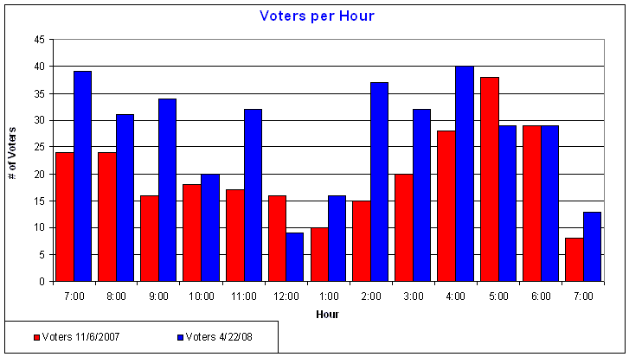
Color has cultural significance
Source: http://ridgerunnerconsulting.com/2008/04/more_voting_statistics/
Notes:
If you were looking at a chart with financial data that used a combination of red and blue what meaning would you infer from those colors? What do these colors signify?

Slide 10
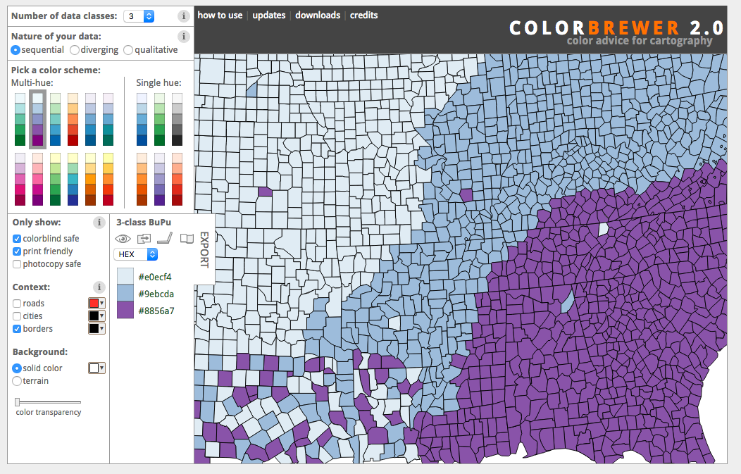
Tools for Picking Color
Color Brewer 2
Adobe Color Wheel
Notes:
It is important to consider your audience in terms of color blindness or other visual impairments. Also ask yourself if the differences in the colors you choose can be rendered when printed in black and white?
Color brewer (http://colorbrewer2.org/)
http://colorlab.wickline.org/colorblind/colorlab/
Adobe Color CC (https://color.adobe.com)

Slide 11
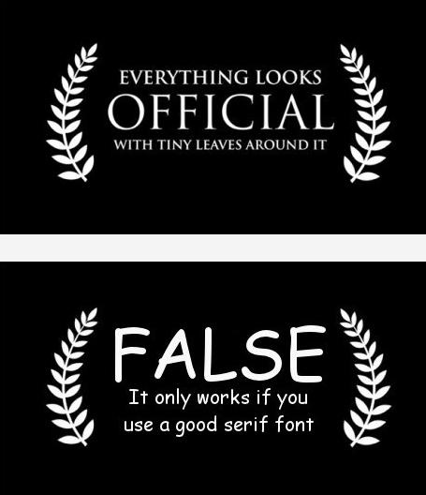
Type
Source: http://digitalsynopsis.com/design/27-funny-graphic-designer-posters-charts/
Notes:
Font choice matters. Consider your audience and what you want to communicate. Most data viz software will default to a legible font (calibri, times new roman, arial). You do not have to stick with the default, but be sure to choose a font that is easy to read and professional.

Slide 12
Limit the use of different font types (2)
Notes:
The text on visualization is meant to explain and clarify. If you use distracting or too many fonts, you risk losing the attention and respect of your audience. Also, remember to increase the font size. Point 8 font is impossible to read.

Slide 13
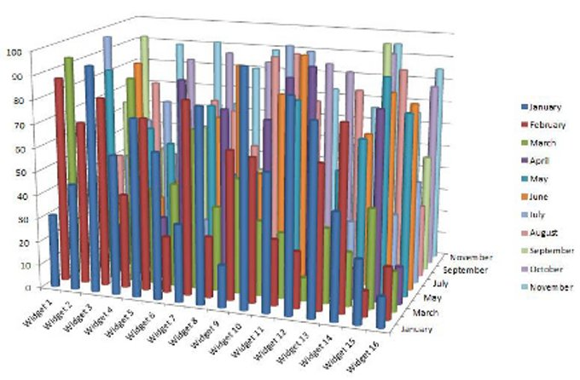
Space
Notes:
What is wrong with this bar graph? This is an extreme example, but you can see that the message is meaningless when too much data is crowded into an inappropriate chart type. Also, avoid 3D charts.
Source: http://cdn.information-management.com/media/newspics/Bling_fig3.jpg

Slide 14
Good vs. Bad Visualizations
Notes:
I’ll talk briefly about some things that make bad visualizations bad, and then get into best practices and general characteristics of good visualizations

Slide 15
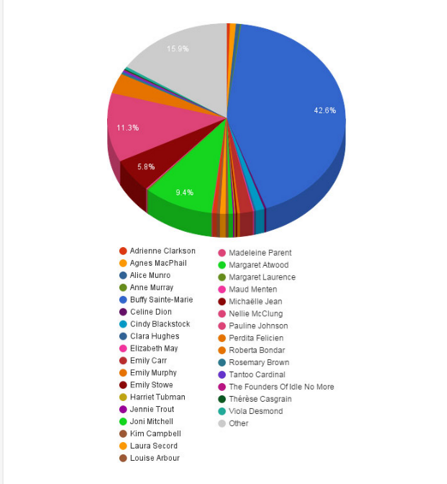
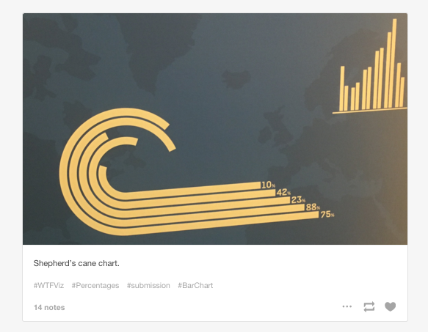
Characteristics of bad visualizations
Notes:
Bad visualizations require viewers to think too much, are confusing, misleading or distracting. Here there are so many choices it’s hard to tell what slice corresponds with what person. Most people can’t differentiate between that many colors. What was the purpose of this visualization? Hard to tell.

Slide 16
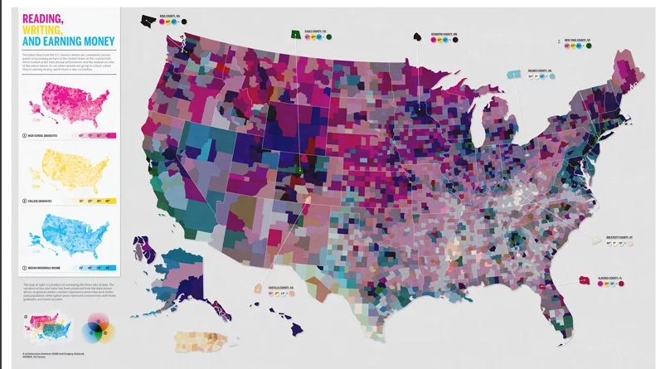
Bad visualizations confuse rather than reveal
Notes:
Some visualizations are bad because the data is too crowded or busy, which makes it difficult to interpret. Here, too many indicators are being visualized at once on this map, making the point of the visualization hard to determine.

Slide 17
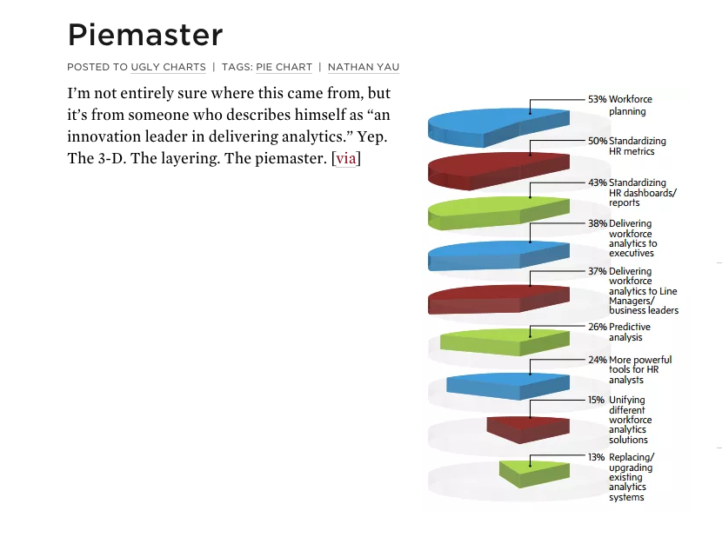
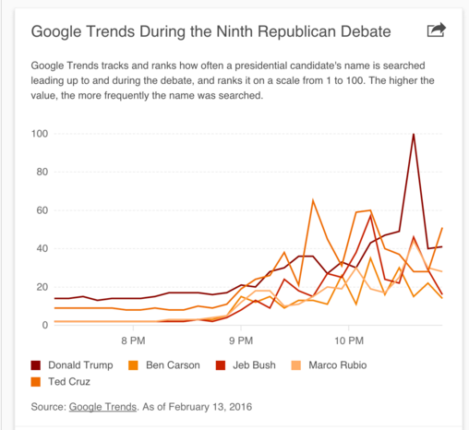
Bad visualizations are disorienting
Notes:
Incorrect use of graphs for the data is also a problem. A pie chart is best viewed in 2D. This view is disorienting and it’s hard to compare slices. The line chart looks inoccuous enough until you realize that it’s hard to distinguish between the colors, which makes it unreadable.

Slide 18
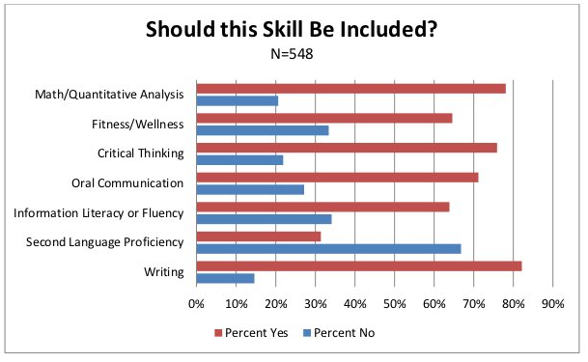
Mediocre visualizations aren’t good
Notes:
Most bad visualizations are simply mediocre. This visualization comes from a college department website and is one of many bad visualizations on that page. This is a bad visualization for a few reasons, some more obvious than others. Problems with this include: bars are unorded to it’s hard to compare across categories. Percentages never add up to 100. Labels are redundant along X axis. With a few changes, we can turn this into a much better visualization that’s easier to read and isn’t misleading.

Slide 19
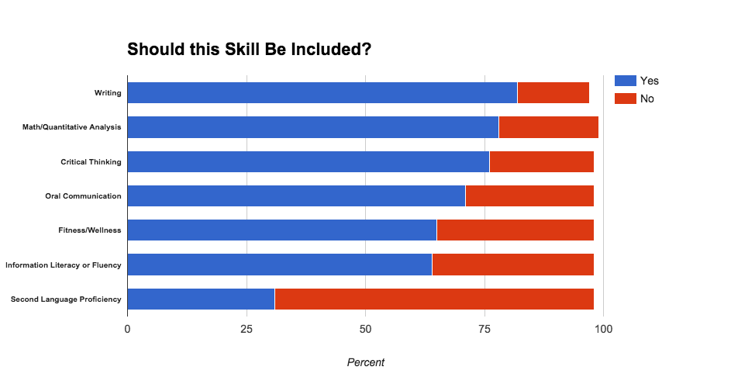
Visualization Makeover: Make it easier to interpret
Regular bar chart, unordered
Stacked bar chart, ordered by % Yes

Slide 20
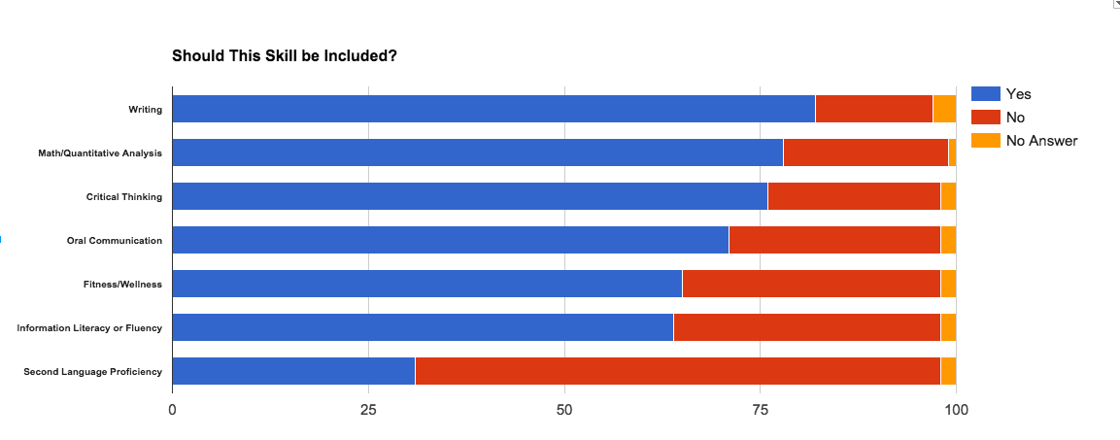
Correct misleading visuals
Tool used: Google sheets
Notes:
If you are recording percents, you need to have them add up to 100. Here, I added in a “No Answer” column to make up for the remaining percent. I could have also used “Other” Since I didn’t have the original data, I had to make the choice.

Slide 21
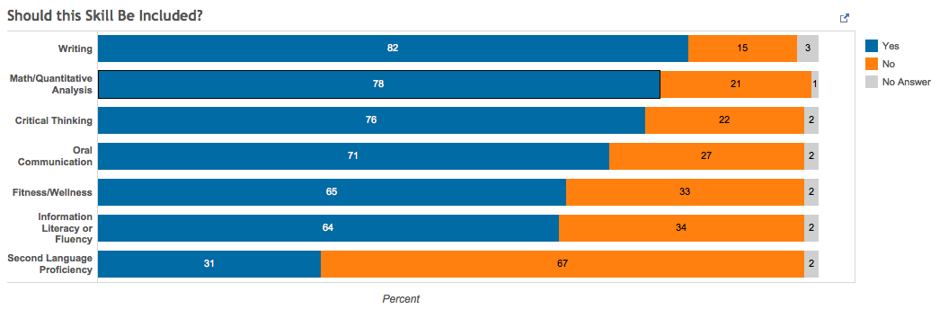
Taking it a step farther: Labels and color
Tool used: Tableau Public (www.tableau.com)
Notes:
Here, I have used colors that are better for people who are colorblind to be able to distinguish differences. I have also added bar labels to it’s really easy to see quickly the breakdown of percentages. This is only necessary if the numbers are important.

Slide 22
Best practices for making good visualizations
Be sure they are necessary.
Start with the story first, then create the visualization.
Make them easy to interpret (8-second rule).
Make them meaty enough to be interesting (not too simple).
Annotate them. Point out what’s important to your audience.
Choose colors that attract, not detract.
Tell a story.
Notes:
Jennifer & Alison

Slide 23
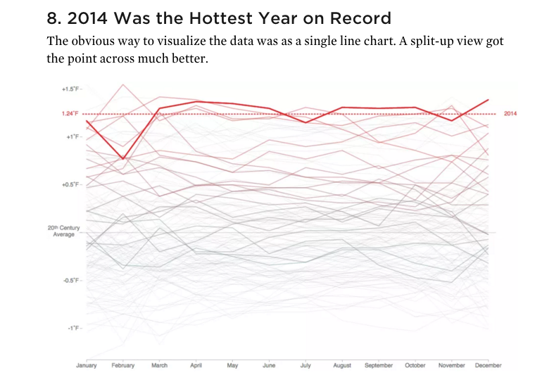
Good visualizations point out what’s important
Source:
Flowingdata.com
Notes:
This line chart would be a bad visualization if all of the lines were bold, but here, the author has used color to highlight what’s important.

Slide 24
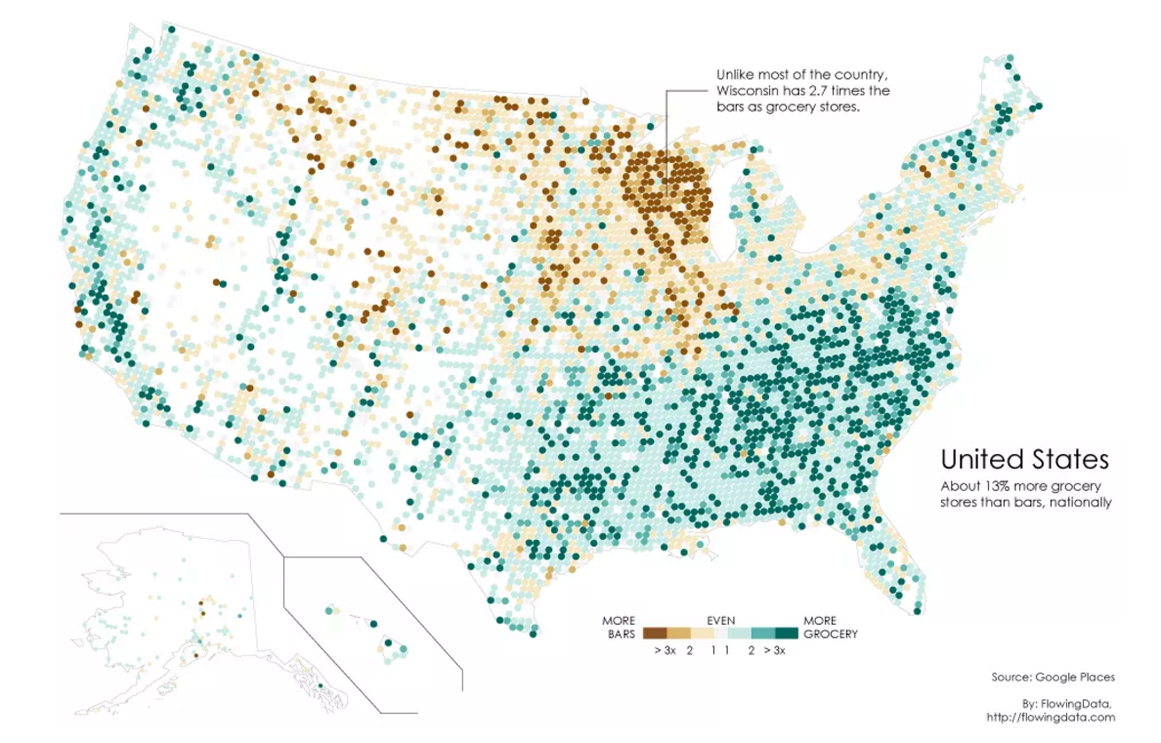
Good visualizations use color and notation to aid interpretation
Notes:
This is a lot of data but this visualization is successful in part because of the color scale used.

Slide 25
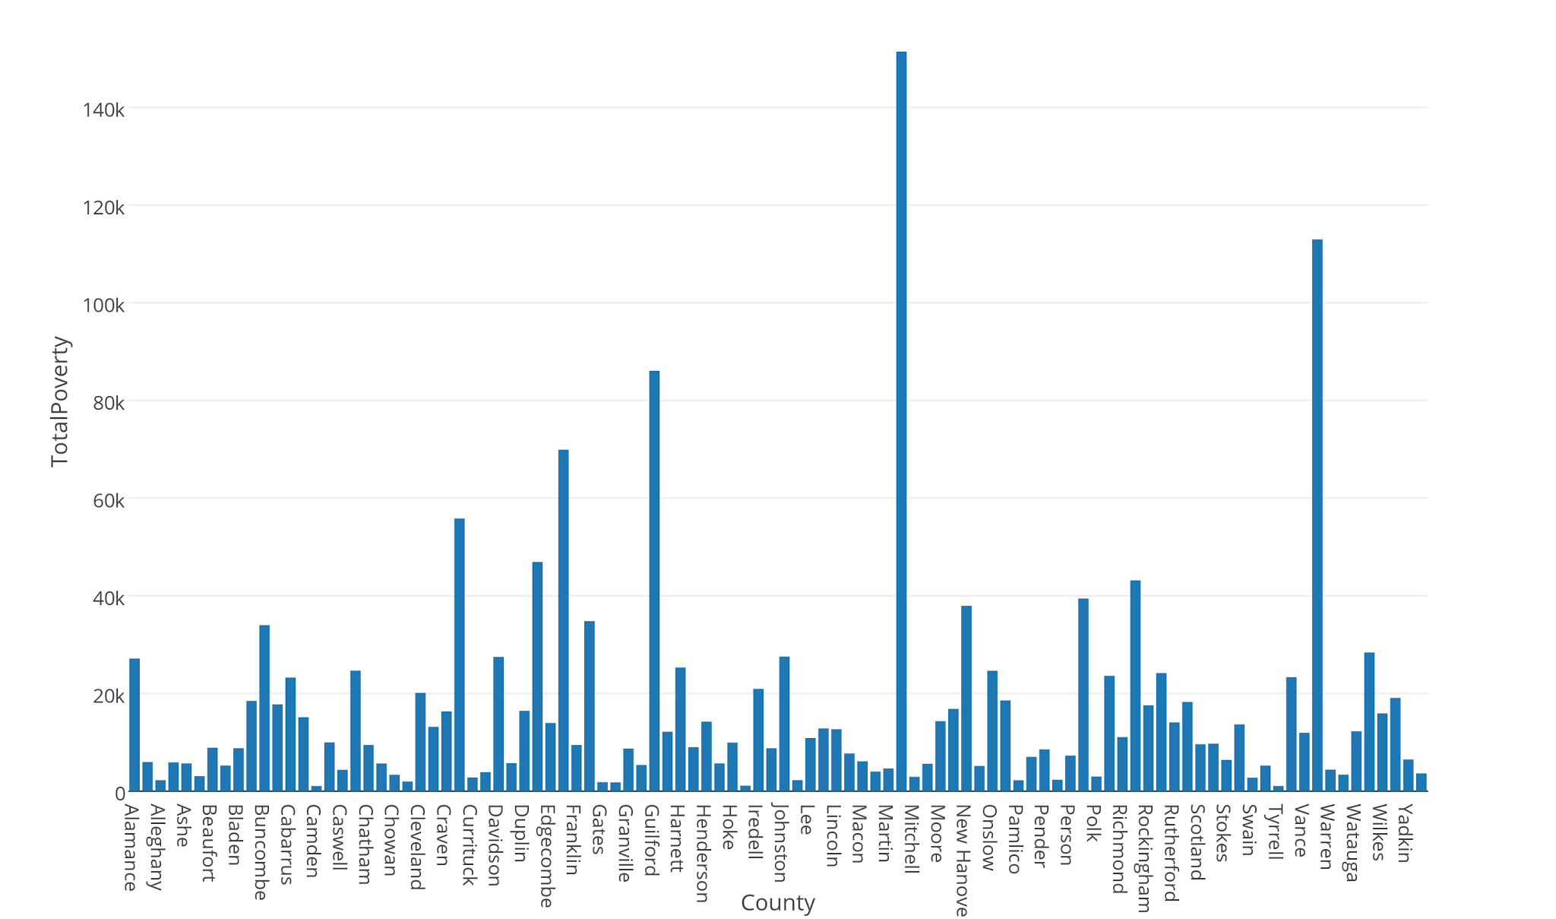
Problems? How could this be made better?

Slide 26
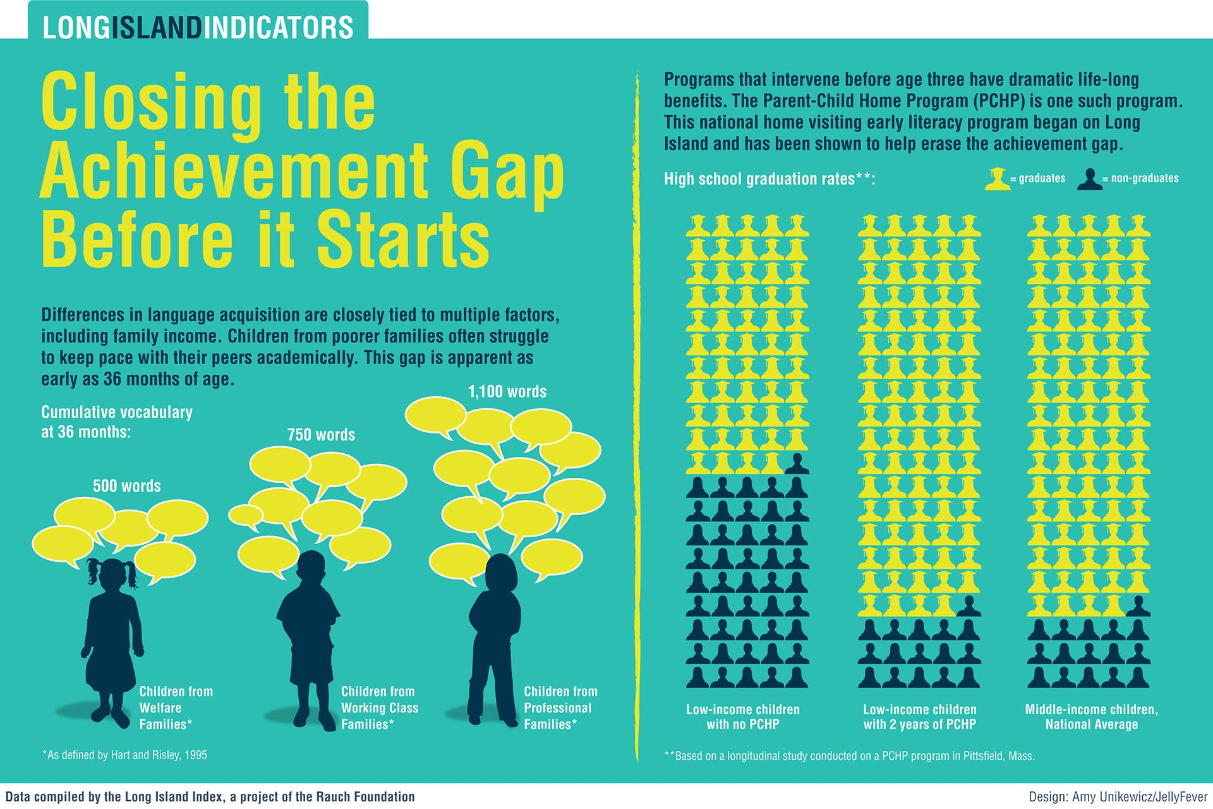
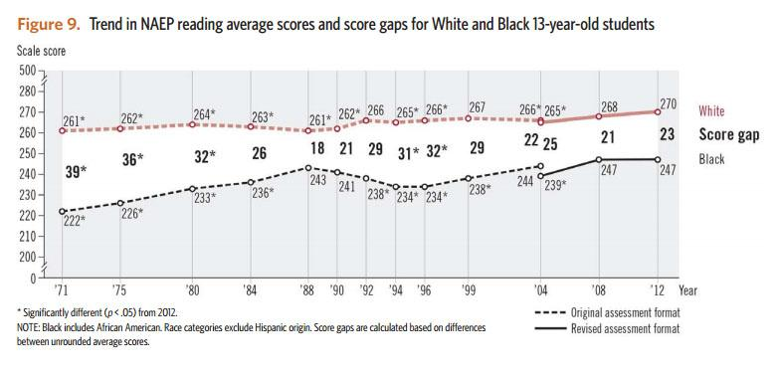
Data Visualizations vs. Infographics
“The [data] visualization is created by a program that can be applied to many datasets, the infographic is hand-crafted for a particular dataset.” - Robert Kosara, Tableau Engineer
Data visualization
Source: http://blogs.edweek.org
Infographic
Source: rauchfoundation.org/
Notes:
Data visualizations, like this line chart, can be made using multiple data sets. Many tools are out there that let you create line charts using software. Infographics have to be hand-designed and aren’t automatically generated. They are specific to each data set.

Slide 27
Choosing the Right Chart Type

Slide 28
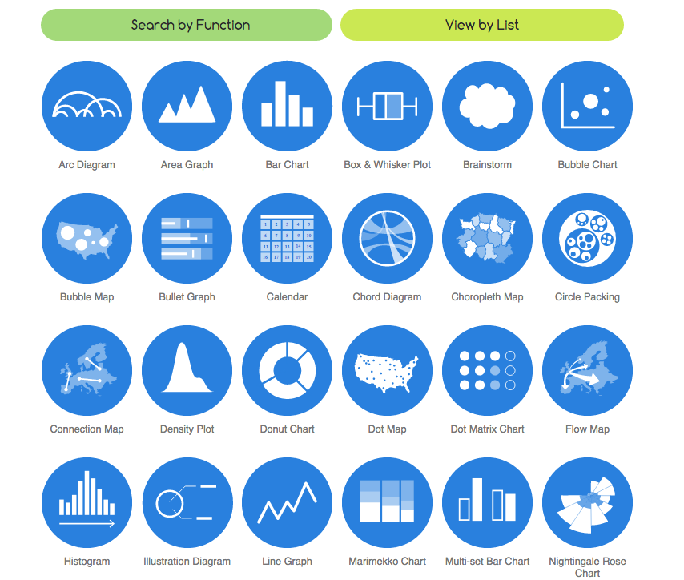
Data Viz Catalogue - www.datavizcatalogue.com
Notes:
Choosing the right chart often depends on what you’re trying to show with your data. The Data Viz catalogue offers some helpful suggestions of chart types and tools.

Slide 29
Alternatives to the status quo
Common chart types may be fine, but there are others out there:
“Six alternatives to the clustered bar chart” - Ann K. Emery
annkemery.com/clustered-bar-chart
“Alternatives to pies” - Cole Nussbaumer Knaflic storytellingwithdata.com/blog/2014/06/alternatives-to-pies

Slide 30
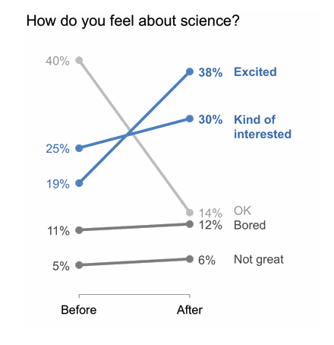
Slope graphs: showing change over time
Notes:
Slope charts can be interesting alternatives to a bar chart or a pie chart -- they can be good for showing change over time, especially before/after comparisons, like pre- and post- survey results

Slide 31
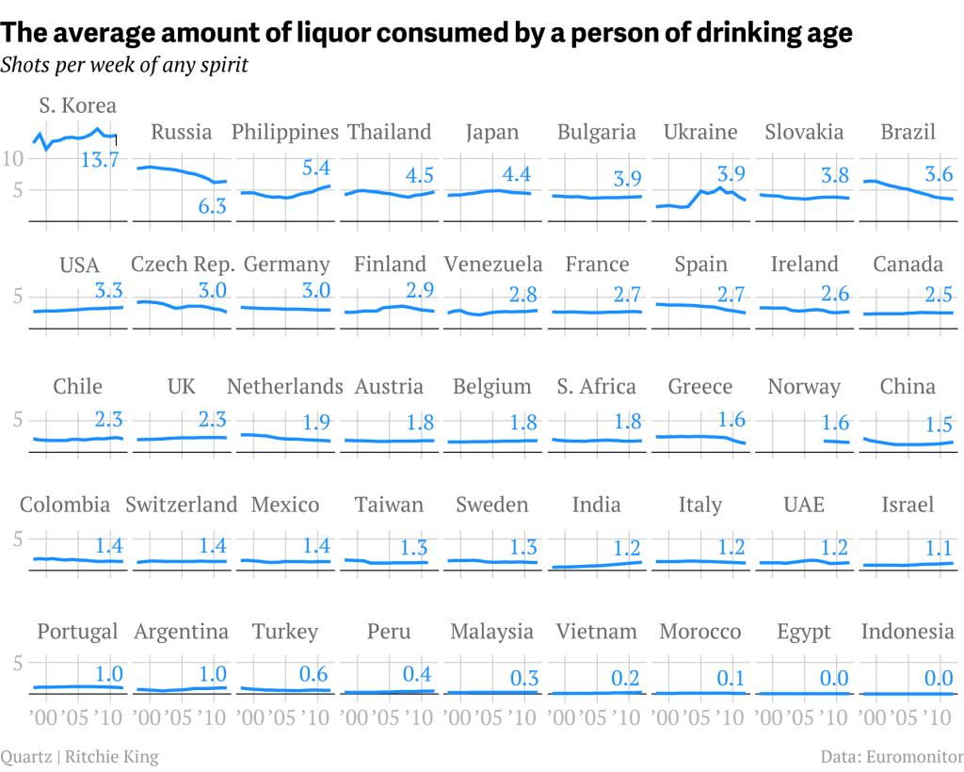
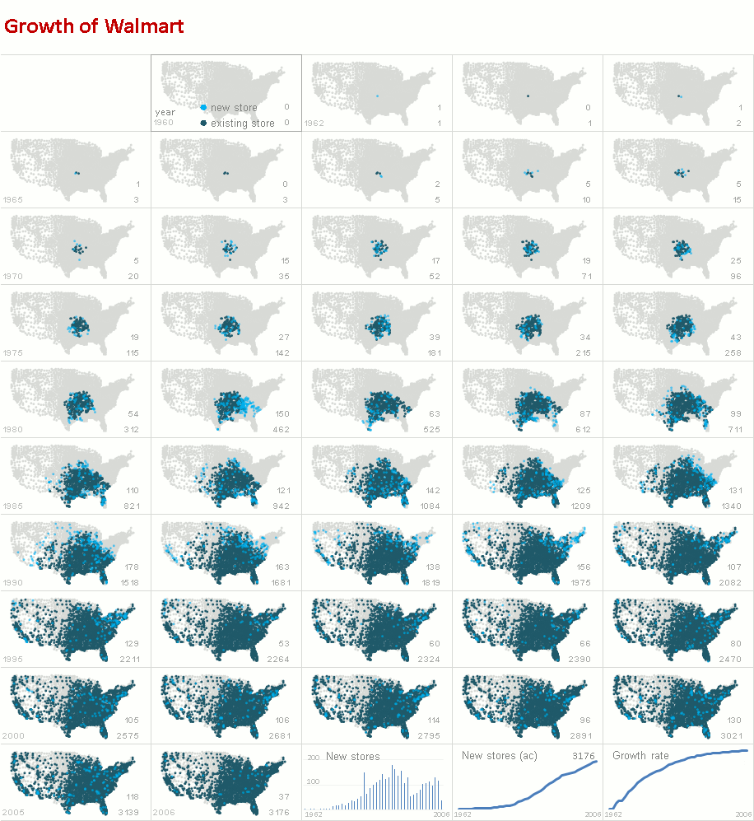
Small multiples charts and maps:
good for showing lots of data without overcrowding
excelcharts.com
Notes:
A great way to prevent having too many lines in one chart and also are good for showing change over time

Slide 32
Additional Design Considerations
Notes:
The following slides will cover some basic design concepts that will help you make informed decisions about designing data visualizations.

Slide 33
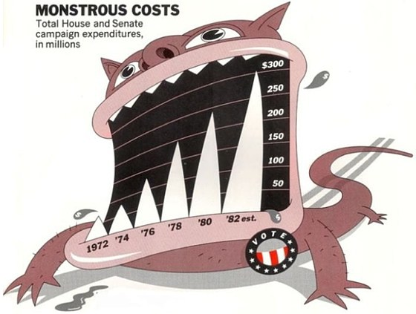
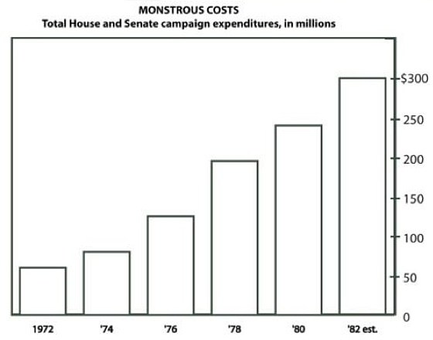
Chart Junk debate
Source: https://eagereyes.org/criticism/chart-junk-considered-useful-after-all
Notes:
The chart junk debate is a classic debate in data visualization between minimalists and those who believe that it’s okay to embellish charts. These two examples are at the extreme ends of the spectrum. Which is better? Neither! Balance is important. Here are ways a few things to consider when designing visualizations…
The one on the right of course looks more professional, but there is no story being told by the visualization. What is the story being told on the left? Here the monster is used as a metaphor for rising campaign expenditures.

Slide 34
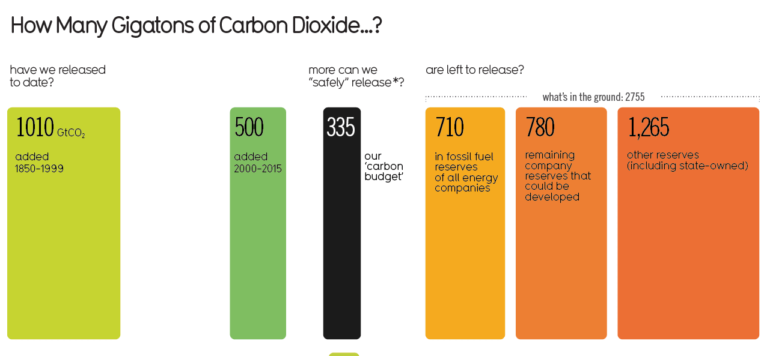
Order & Size
Source: http://www.informationisbeautiful.net/visualizations/how-many-gigatons-of-co2/
Notes:
The scale, or size, and order of this chart do not clearly communicate a cohesive message. Does it make comparison easy? What could be done better? This example is borrowed from an infographic. Disclaimer: infographics can often be more narrative and less about accurate data visualization.

Slide 35
Further Resources
“Color Harmonies: Basic Techniques for Combining Colors” (Tiger Color website)
Jumpstart Tableau [electronic resource]: A Step-by-Step Guide to Better Data Visualization (Arshad Khan)
Data visualization [electronic resource] : a successful design process (Andy Kirk)
The functional art : an introduction to information graphics and visualization (Alberto Cairo)

Slide 36
Activity
Download the “Bad Examples” Tableau workbook here
Examine the data set: HollywoodsMostProfitableStories.csv
Launch the Tableau application
Open “Bad Examples.twbx” in Tableau.
Work with others at your table or individually to make these visualizations look better, using design principles. Find at least two problem areas to fix.
Either sketch your improved version on the whiteboard or use Tableau if you are familiar with the software.

Slide 37
Improved examples
Here’s a link to a workbook with the examples from the activity:
https://public.tableau.com/profile/al.blaine#!/vizhome/ImprovedExamples/AudienceScorevsWorldwideGross

